Slide 1
Software Design Principles
Michel R.V. Chaudron
Software Architecture 2018
chaudron@chalmers.se | chaudron@cse.gu.se

Slide 2
Schedule
Week |  | Date | Time | Lecture | Reading | Assignmnt
36 | L1 | 5 sept | 13:00 – 15:00 | Introduction & Organization
37 | L2 | 12 sept | 13:00 – 14:30 | Architecting Process & Views | Ch 1 & 2
37 | S1 | 13 sept | 10:15 - 1200 | << Supervision/Assignment>> |  | Release Ass 1.0
38 | L3 | TUE 18 sept | 15:15 – 17:00 | Views, Viewpoints & Quality Attributes | Ch 3 & 4
38 | S2 | THU 20 sept | 13:00 – 15:00 | << Supervision/Assignment>> | IEEE standard | Continue Ass 1
38 | L4 | FRI 21 sept | 13:15 – 15:00 | Architectural Styles 1 | Ch 13
39 | L5 | MON 24 sept | 14:00 | deadline |  | hand in for Ass 1
 |  | WED 26 sept | 14.00-15.30 | Seminar Claudia Eckart (Room Tesla) + coffee | Ch 15 & 16 | Location: Lindholmen conference centre, Lindholmspiren 5
39 | S3 | THU 27 sept | 10:15 – 12:00 | << Supervision/Assignment>> |  | release Ass 2.0
39 | L6 | 28 sept | 13:15 – 15:00 | Architectural Styles | Ch 13
40 | L7 | 3 Oct | 13:15 – 15:00 | Technical Debt | See paper on Tech Debt on GUL
40 | S4 | 4 Oct | 10:15 – 12:00 | << Supervision/Assignment>> |  | supervision
40 | L8 | 5 Oct | 13:15 – 15:00 | Roles and Responsibilities | Characterising Classes (Wirf-Brocks)
41 | L9 | 10 Oct | 13:15 – 15:00 | Design Principles | Ch 21
41 | S5 | 11 Oct | 10:15 – 12:00 | << Supervision/Assignment>> |  | Mandatory workshop!
 |  | 15 Oct |  |  |  | hand in Ass 2.0
42 | L10 | 17 Oct | 13:15 – 15:00 | Magnus Standar from Ericsson.
 |  | 18 Oct | 10:15 – 12:00 | << Supervision/Assignment>> |  | Feedback on Ass 2
42 | L11 | 19 Oct | 13:15 – 15:00 | Architecture Evaluation | MODELS
43 | L12 | 24 Oct | 13:15 – 15:00 | Reverse Engineering & Correspondence | Ch 20
43 | S6 | 25 Oct | 10:15 – 12:00 | << Supervision/Assignment>>
43 | L13 | 26 Oct | 13:15 – 15:00 | To be determined |  | Architectural Styles 2
 |  |  |  |  |  | …

Slide 3
Recap
Architectural Styles
Tactics

Slide 4

Advice on Design of Software
Generic Design Principles
Principles for Architectural Design
Principles for Design of Components
Principles for collaboration amongst Components
Design = trade-offs = gray area
➔ Principles are heuristics
Not today: User Interface design, protocol design

Slide 5
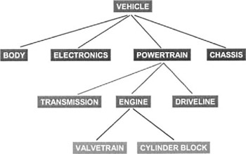
Generic Design Principles
Decomposition
Break problem into independent smaller parts
Independent?

Slide 6
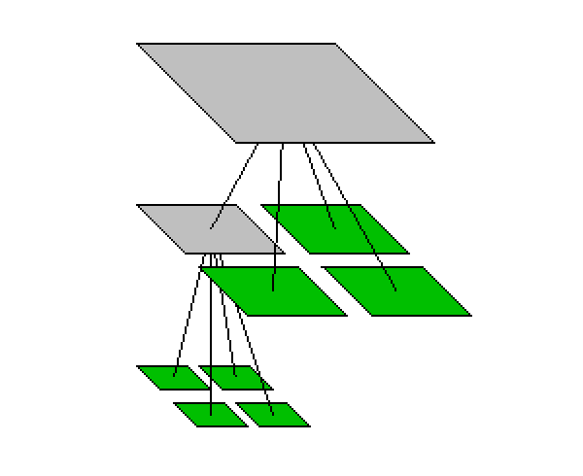
Design Principle : Divide and conquer
Trying to deal with something big all at once is harder than dealing with a set of smaller things
Each individual component is smaller, and therefore easier to understand
Parts can be replaced or changed without having to replace or extensively change other parts.
Separate people can work on separate parts
An individual software engineer can specialize

Slide 7
Ways of dividing a software system
A system is divided up into
Layers & subsystems
A subsystem can be divided up into one or more packages
A package is divided up into classes
A class is divided up into methods

Slide 8
Subsystems vs Layering
Functional
Dimension
Fuel System
Propulsion System
Electrical System
Braking System
Layer 1
Layer 2
Layer 3
Abstraction
Dimension
Again: natural language is used in imprecise manner

Slide 9
Layering
Goals: Separation of Concerns, Abstraction, Modularity, Portability
Partitioning in non-overlapping units that
provide a cohesive set of services at an
abstraction level
(while abstracting from their implementation)
layer n is allowed to use services of layer n-1
(and not vice versa)
alternative:
bridging layers: layer n may use layers <n
enhances efficiency but hampers portability
3
2
1
0
Notes:
A layer structure can e.g. be used to implement a functional hierarchy
Strict layering: layer n can use layer n-1
Loose layering: layer n can use layers k s.t. k<n
Loose layering reduces portability/replacebility of layers.

Slide 10
Consistency in two dimensions

Slide 11
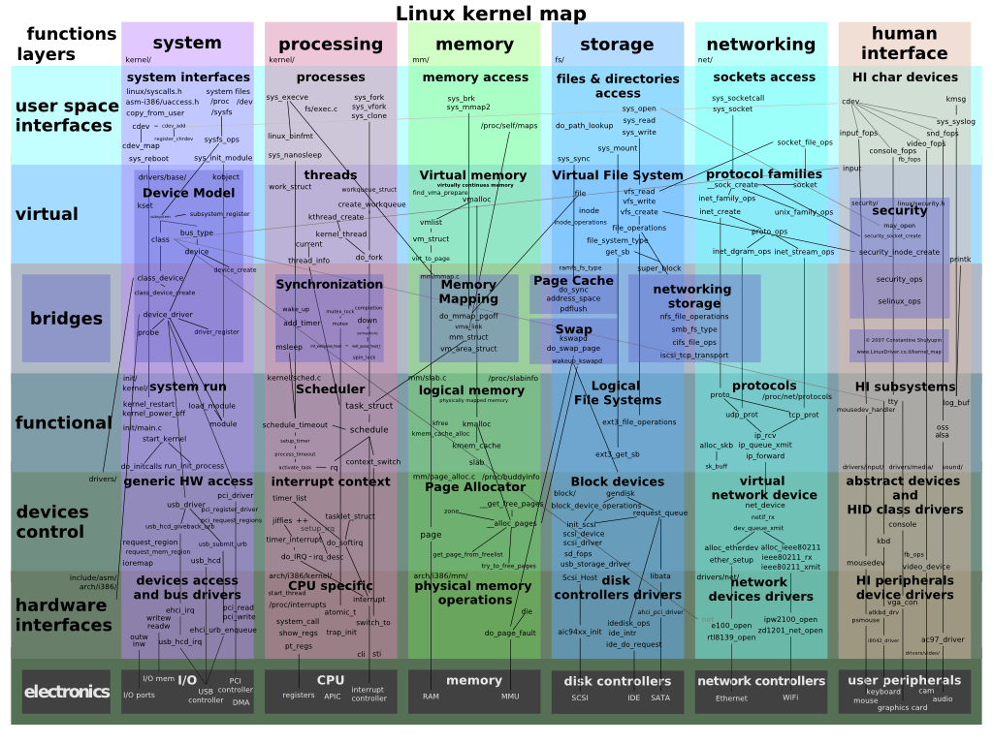
Consistency in two dimensions

Slide 12
A Component-based Reference Architecture for Computer Games (E. Folmer, 2007)
specific
generic

Slide 13
Example
«layer»
«layer»
Presentation and Dialogue Layer
Common Elements
«subsystem»
«subsystem»
Client / Browser
Client Authentication
«subsystem»
«subsystem»
«subsystem»
«subsystem»
S
M
P
M
C
«subsystem»
«subsystem»
«subsystem»
D
F
«subsystem»
E
«layer»
Business Layer
«subsystem»
«subsystem»
«subsystem»
«subsystem»
JR
M
P
M
C
«subsystem»
«subsystem»
«subsystem»
«subsystem»
D
F
Apache
«layer»
«subsystem»
«subsystem»
Persistence Layer
RC
Data Security
«subsystem»
«subsystem»
«subsystem»
P
M
M
PL
«subsystem»
«subsystem»
«subsystem»
«subsystem»
C
D
F

Slide 14
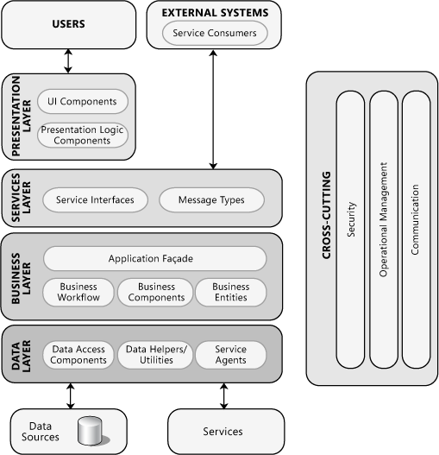
Reference Architecture
Generic (i.e. not application-specific) Design.
Generally believed for Information Systems
Not so very different for embedded systems
From: Microsoft Application Architecture Guide, 2nd Edition
http://msdn.microsoft.com/en-us/library/ff650706.aspx

Slide 15
What is a dependency?
A
A depends on B
B
Component A requires B for it to work
Functional coupling
A change in module B requires a change in module A
Implementation coupling
Typically requires: re-testing A & B
Run-time
Development-time

Slide 16
Dependency/Coupling
There is coupling between two classes A and B if:
A calls a service of an object B
A has a method which references B
(via return type or parameter)
A has an attribute that refers to B
A is of type (inherits from) B
A is a subclass of (or implements) class B
This is not an exhaustive definition
A may depend on some assumption on another component B

Slide 17
Architecture Design Principles
Dependencies direct in the direction of stability
A
B is less likely to change than A
B

Slide 18


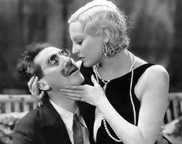

Dependency: Coupling
Coupling is the degree of interdependence
between modules
high coupling
low coupling

Slide 19
Coupling and Cohesion
Coupling is a measure of dependency between modules.
Cohesion is a measure of the coherence of a module amongst the pieces of that module.
In a system design, one wants high cohesion and low coupling
within components between components

Slide 20
Benefits of Low Coupling/Dependencies
Modules are easier to replace
fewer interconnections between modules reduce time needed for understanding the modules and interactions
fewer interconnections between modules reduce the chance that changes in one module cause problems in other modules, which enhances reusability
fewer interconnections between modules reduce the chance that a fault in one module will cause a failure in other modules, which enhances robustness
Page-Jones, M. 1980. The Practical Guide to Structured Systems Design. New York, Yourdon Press, 1980.

Slide 21
Inheritance = Coupling
99.9% of the time I find that it makes sense to assign all of the classes of a hierarchy, either an inheritance hierarchy or a composition hierarchy, to the same component.
Scott Ambler
Inheritance implies cohesiveness

Slide 22
Reducing Coupling: Information Hiding
Information Hiding:
Try to localize future change
Hide system details likely to change independently
Separate parts that are likely to have a different rate of change
In interfaces expose only assumptions unlikely to change
Why is information hiding a good idea?
which types of coupling are prevented/reduced?

Slide 23

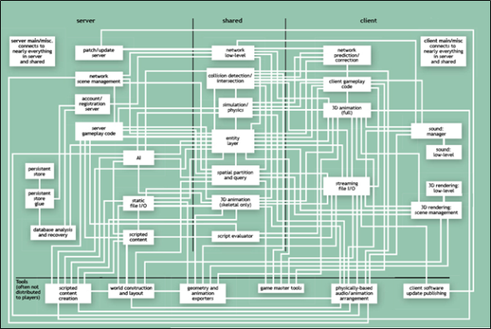
David Parnas
We propose that one begins with a list of:
difficult design decisions, or
design decisions which are likely to change
Each module is then designed to hide such a decision from the other modules.
David Parnas
1941-…
Goal: ISOLATE CHANGE
Means: Information hiding, minimizing dependencies
I advise students to pay more attention to the fundamental ideas rather than the latest technology.
The technology will be out-of-date before they graduate. Fundamental ideas never get out of date.
Notes:
"On the Criteria To Be Used in Decomposing Systems into Modules". http://www.cs.umd.edu/class/spring2003/cmsc838p/Design/criteria.pdf.
I would advise students to pay more attention to the fundamental ideas rather than the latest technology.
he technology will be out-of-date before they graduate. Fundamental ideas never get out of date.

Slide 24


Design Principle: Information Hiding
what is inside, must stay inside.

Slide 25
Example 1
IPrimeEncrypt(m,p)
ICeasarEncrypt(m,s)
IEncrypt(m)
Information hiding guides the design of the interface
The interface should aim to be:
generic
We can do this by stating ‘what’, but not ‘how’
We can do this by avoiding unnecessary parameters in the calling of the component

Slide 26
Example 2
Steer a vehicle
Interface
Option 1: Isteer = {TurnLeft, TurnRight}
Option 2: Isteer = {PressLeft, PressRight}
Option 3: Isteer = {Left, Right}

Slide 27
Single Responsibility
What is a responsibility?
Depends on level of design
Relates to Parnas Information Hiding:
The responsibility relates to the secret
E.g. sorting
Viewer: way of displaying information
Model: storing & querying information
Alternative formulation (‘Uncle Bob’):
A class should have only one reason to change

Slide 28

WHAT versus HOW
‘WHAT’: think Responsibility, Declarative
Mechanisms are about ‘HOW’
WHAT: Build a house
HOW: stone, sticks, straw

Slide 29


Example: Change implementation
Build_House()
Sort()
Store()
Public Interface
Sorter
Database
Builder
straw
Bubble sort
stone
Quick sort
DB
Cloud
Suports evolution and platform-independence

Slide 30
Reducing Coupling: Facade pattern

Slide 31
Reducing Coupling: Facade pattern
What is changed? Functional Coupling or Implementation Coupling?

Slide 32
Cohesion
Cohesion is concerned with the relatedness
within a module
high cohesion
low cohesion
Heuristic:
Keep things together that belong together
High cohesion within a module is good

Slide 33
Design Principles
Keep things that belong together at a single place
e.g. in OO: data and
the operations on that data
Don’t replicate
functionality, storage of data

Slide 34
The Common Reuse Principle
Classes that are used together are packaged together
If you use one class of a package,
you will use all its other classes too.

Slide 35
The Common Closure Principle
Classes that change together are packaged together

Slide 36
Example Design Case: Web Shop

Slide 37
Example Design Case: Web Shop
register
login
search
add item to
catalogue
add item to cart
remove item
from catalogue
customer
shop owner
remove item from cart
add to stock
pay items in cart
package & ship

Slide 38
Structure/Group Functionality
Defines subsystems of functionality
Purpose
Define decomposition into subsystems
Provide support for use-cases
Think in terms of responsibilities
Use Component diagram
May use Class, but this suggests OO implementation

Slide 39
Web Shop: Functional Areas (V0.1)
Customer
Registration
Shop Owner
Registration
Product Catalogue
Management
Payment
Stock Control

Slide 40
Check Use Cases Against Functional Areas
login
Customer
Registration
Shop Owner
Registration
login
register
add item to
catalogue
search
Product Catalogue
Management
remove item
from catalogue
Payment
Stock Control
pay items in cart
add to stock
?
package & ship
add item to cart
remove item from cart

Slide 41
Web Shop: Functional Areas (V0.2)
login
Customer
Registration
Shop Owner
Registration
login
register
add item to
catalogue
Product Catalogue
Management
search
remove item
from catalogue
Payment
Stock Control
pay items in cart
add to stock
Excluded from example
Payment adm
Shop staff salary adm
...
add item to cart
package & ship
Customer Selection
Management
remove item from cart
Notes:
I consider as alternative name for Customer Selection Management to be Customer Session Management

Slide 42
Web Shop: Responsabilities
Customer Registration
Entry, storage & retrieval of customers
Shop Owner Registration
Entry, storage & retrieval of shop staff
Product Catalog Mngmt
Entry, storage & retrieval of product data
Cust. Selection Mngmt
Register customer product selection
Payment
Handle transaction between customer & shop
Stock Control
Register available products in stock
Shop UI
Interact with user (I/O)

Slide 43

Characterizing Classes according to Rebecca J. Wirfs-Brock, IEEE Software, March/April 2006
■ Information holder: an object designed to know certain information and provide that information to other objects.
■ Structurer: an object that maintains relationships between objects and information about those relationships.
Complex structurers might pool, collect, and maintain groups of many objects; simpler structurers maintain relationships between a few objects. An example of a generic structurer is a Java HashMap, which relates keys to values.
■ Service provider: an object that performs specific work and offers services to others on demand.
■ Controller: an object designed to make decisions and control a complex task.
■ Coordinator: an object that doesn’t make many decisions but, in a rote or mechanical way, delegates work to other objects. The Mediator pattern is one example.
■ Interfacer: an object that transforms information or requests between distinct parts of a system. The edges of an application contain user-interfacer objects that interact with the user and external interfacer objects, which communicate with external systems. Interfacers also exist between subsystems. The Facade pattern is an example of a class designed to simplify interactions and limit clients’ visibility of objects within a subsystem.
Notes:
These are subsystem ‘archetypes’

Slide 44
Identification of Dependencies
Shop UI
Staff Shop UI
Customer
Registration
Cust. Sel.
Mngmt.
Cart-
data
Payment
Prod. Catal.
Maint.
Stock
Control
Shop Staff
Registration
Customer
data
Product
Catalogue
Stock
data
Shop
Staff
data
key
uses
Subsystem
<< subsystem>>
package
Notes:
Drawing the picture this way, makes it clear that a separate Staff Shop UI is needed

Slide 45
Introduce layer for business logic
Shop UI
Staff Shop UI
Business Process Coordinator
Customer
Registration
Cust. Sel.
Mngmt.
Cart-
data
Payment
Prod. Catal.
Maint.
Stock
Control
Shop Staff
Registration
Customer
data
Product
Catalogue
Stock
data
Shop
Staff
data
key
uses
Subsystem
<< subsystem>>
package
Notes:
Drawing the picture this way, makes it clear that a separate Staff Shop UI is needed

Slide 46
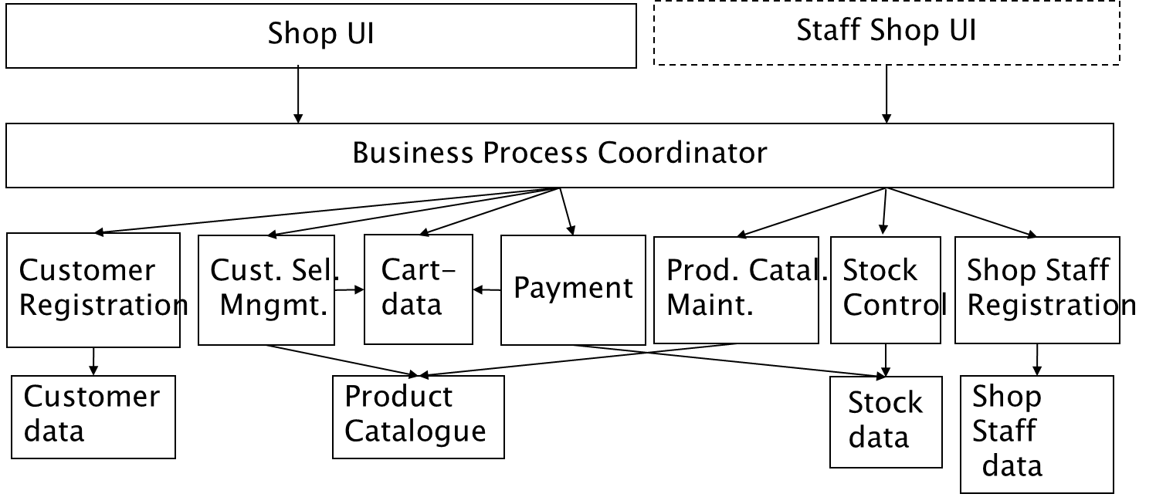
Interfacers
Coordinator
Service Providers
Information holders

Slide 47

Elaboration of Data Domains
Customer
name+address
authentication
Customer Registration
Shop staff
name
authentication
Shop Staff Registration
Prod. Cat. Mngmnt
Product
product-id
price
Cust. Selection Mngmt
Cart
product-id
quantity
Payment
volatile
Stock Control
Stock data
product-id
quantity

Slide 48
Identify support for Use Cases at different layers in the architecture
login
presentation
layer
login screen
search screen
…
register
select item
check -out
search
…
manage cart
business logic layer
pay items in cart
add item to cart
user table
product table
…
data mngmt layer
remove item from cart

Slide 49
Web Shop Deployment Diagram
Internet Client
Backend System
Shop UI
Staff Shop UI
Staff Shop
Registration
Cust. Selection
Management
Customer
Registration
Stock Control
Product
Cat. Maint.
Cart Data
Payment
Internet
Local Area Network
Gateway
Firewall
Shop Staff
Stock
Customer
DB
Product
Catalogue

Slide 50
Design System Dynamics: Scenario’s
Shop UI
Product
Catalogue
Customer Selection
Management
Cart-data
customer
query
Enter search
Matches of search
e2e deadline
1,0 sec.
Select item
Update selection
Store selection
Scenario’s describe the interaction between components
Notes:
Drawing the picture this way, makes it clear that a separate Staff Shop UI is needed

Slide 51
Identification of Active Processes
Shop UI
Staff Shop UI
Customer
Registration
Cust. Sel.
Mngmt.
Cart-
data
Payment
Prod. Catal.
Mmgmt
Stock
Control
Shop Staff
Registration
Customer
data
Product
Catalogue
Stock
data
Shop
Staff data
key
uses
Active
Component
Passive
Component
Notes:
Drawing the picture this way, makes it clear that a separate Staff Shop UI is needed

Slide 52
Architecture Design Principles
No Circular Dependencies
Callers must depend on callee, not vice versa
Which earlier design advice does this violate?
Decomposition

Slide 53

Generic Design Principle
Separation of Concerns ( = Decomposition)
Issues that are not related should be handled in separate parts

Slide 54
Example Separation of Concern Principle
Telecom Domain:
Telecom protocol:
decode1 ; handle1 ; decode2 ; handle2 ; decode3
handle & encode/ decode
Separate the encoding/decoding of a message from the handling of a message:
decode1 ; decode2 ; decode3 ; handle1 ; handle2
handle
encode/ decode

Slide 55

Separation of Concerns in Interface Design
Separate What from How
The interface of a component exposes what it do, but not how it does this.
The ‘how’ is the information-hiding ‘secret’
Details of the data representation
Details of the algorithm

Slide 56
Example What from How
Drawing for different platforms
(windows, ios)

Slide 57
Separate what from how
What is the best name for a sorting algorithm?
Quicksort
Sort
Bubblesort
Mergesort
Don’t expose implementation details via an Interface / API

Slide 58
What is Modularity?
We can “see it” via a
Design Structure Matrix (DSM) Map

Slide 59
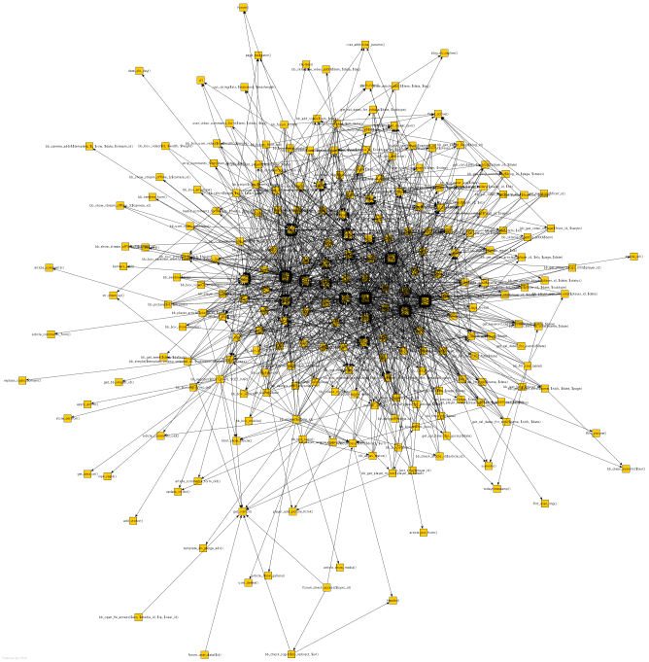
Visualizing Structure as Graph or Matrix
An edge running from the node a to the node b represents a call of function b from function a

Slide 60
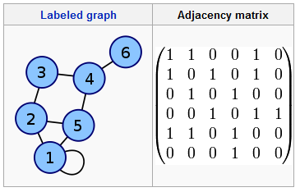
Design Structure Matrix Map of a Laptop Computer
Dependencies between subsystems

Slide 61
Design Structure Matrix Map of a Modular System

Slide 62
Importance of modularity
Software qualities
Maintainability
Extensibility
Flexibility
Reusability
⇒ good software architecture
Software architecture
Modulair structure (modules en relations)

Slide 63
DSM of Mozilla before and after redesign
number of files
2.4 dependencies per KSLOC
1.3 dependencies per KSLOC
Formerly Mozilla was the commercial Netscape Navigator, then released into open source.
From: Exploring the Structure of Complex Software Designs: An Empirical Study of Open Source and Proprietary Code, Alan MacCormack, John Rusnak, Carliss Baldwin, Harvard Business School, draft October 1st 2005

Slide 64
General Software - Design Principles 1
Information Hiding:
All information about a module should be private to
the module unless required externally
Minimize Coupling
Every module should depend on as few
others as possible
Coherence: Keep things together that belong together
Keep behaviour together with related data
Keep information about one thing in one place

Slide 65
General Software Design Principles 2
Divide and Conquer
Break a big problem into smaller ones
Separation of Concerns
Divide into different parts logic that addresses different issues
Keep it Simple

Slide 66
Take Aways for Software Architecture
“If you think education is expensive, try stupidity”
Yes there is upfront investment, but when done wisely this will pay off.

Slide 67

Simplicity
Simplicity is a great virtue but it requires hard work to achieve it and education to appreciate it.
And to make matters worse:
Complexity sells better.
Source: Edsger W. Dijkstra EWD896 - On the nature of Computing Science
Turing Award (1972)

Slide 68

Edsger Wybe Dijkstra
1930-2002
Ph.D. in Physics Leiden University, NL
Contributions to:
Algorithms, Concurrency, Distributed Systems, Program Correctness, Discipline of Design:
Structured Programming (Go To considered Harmful)
Separation of Concerns
Turing Award (1972)
O.-J. Dahl, E. W. Dijkstra, C. A. R. Hoare, Structured Programming, Academic Press, London, 1972
Notes:
O.-J. Dahl, E. W. Dijkstra, C. A. R. Hoare Structured Programming, Academic Press, London, 1972 ISBN 0-12-200550-3

Slide 69
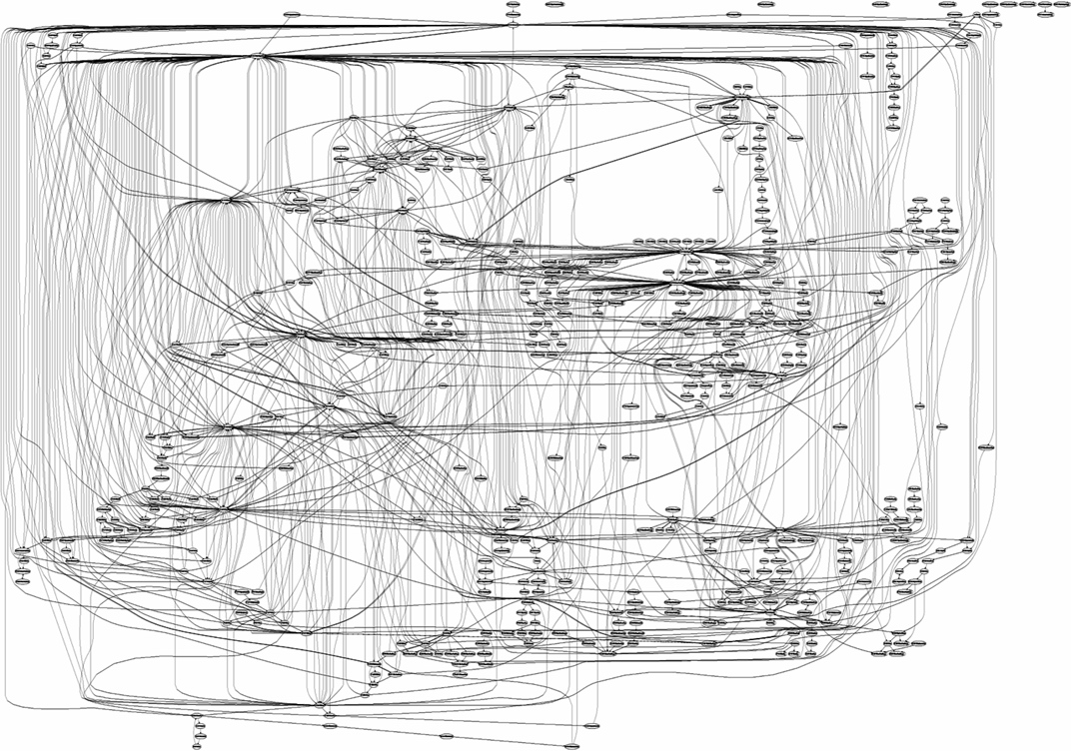
Spaghetti ?
Aesthetics count !

Slide 70

Generic Design Principles
Keep it Simple (KIS)
Structured, Consistent

Slide 71

For you: no shortcuts! ! No sloppiness!!

Slide 72

Research Questions in Software Design
Can we automatically assess the quality of a software architecture design?
Grading Robot!
Can we assess whether the implementation conforms to the architecture? Where does it deviate?

Slide 73
You can't maximize all design principles at the same time.
Keep them in mind while you are working on a component.

Slide 74
Questions?

Slide 75
Which logical design flaw is made in this record definition?
Record employee = { name : string
email : string
age : integer
years-in-service: integer
salary : integer }

Slide 76
Study in Software Understanding/Explanation
Research Question:
How to best explain a system to a new developer ‘on-boarding’?
Context:
Typical setting in software maintenance
‘Newbies’ carry out a task with help/supports from experienced developer
Purpose:
Are there patterns in the conversations?
Can we identify typical strategies/difficulties in understanding?

Slide 77

API Design – Joshua Bloch
http://lcsd05.cs.tamu.edu/slides/keynote.pdf

Slide 78
Also see
http://msdn.microsoft.com/en-us/library/ee658124.aspx#KeyDesignPrinciples

Slide 79
Design of Control Styles
Delegated
Slide by R. Wirff-Brocks
Centralized
pro’s / con’s?
Overly Distributed

Slide 80
Types of Coupling
Data coupling
data from one module is used in another
Data type coupling
two modules use the same data type
Control coupling
actions one module are controlled
by another module (switch)
Content coupling
a module refers to the internals of another module
considered worse
Bind to interface of components
Notes:
From Scott Ambler:
Highly coupled classes belong in the same component. When two classes collaborate frequently, this is an indication they should be in the same domain component to reduce the network traffic between the two classes. This is especially true when that interaction involves large objects, either passed as parameters or received as return values. By including them in the same domain component you reduce the potential network traffic between them. The basic idea is that highly coupled classes belong together.
Minimize the size of the message flow between components. Client/server classes belong in a domain component, but there may be a choice as to which domain component they belong to. This is where you need to consider issues such as the information flow going into and out of the class. Communication within a component will often be simple message sends between objects in memory, communication between components may require an expensive marshalling effort in which a message and its parameters are converted to data, transmitted, and then converted back into a message again.

Slide 81
Characterizing Classes according to Rebecca J. Wirfs-Brock, IEEE Software, March/April 2006
■ Information holder: an object designed to know certain information and provide that information to other objects.
■ Structurer: an object that maintains relationships between objects and information about those relationships.
Complex structurers might pool, collect, and maintain groups of many objects; simpler structurers maintain relationships between a few objects. An example of a generic structurer is a Java HashMap, which relates keys to values.
■ Service provider: an object that performs specific work and offers services to others on demand.
■ Controller: an object designed to make decisions and control a complex task.
■ Coordinator: an object that doesn’t make many decisions but, in a rote or mechanical way, delegates work to other objects. The Mediator pattern is one example.
■ Interfacer: an object that transforms information or requests between distinct parts of a system. The edges of an application contain user-interfacer objects that interact with the user and external interfacer objects, which communicate with external systems. Interfacers also exist between subsystems. The Facade pattern is an example of a class designed to simplify interactions and limit clients’ visibility of objects within a subsystem.
Notes:
These are subsystem ‘archetypes’

Slide 82
Assigning Responsibilities ...
Keep information about one thing in one place
if multiple objects need access to the same information
a new object may be introduced to manage the information, or
one object may be an obvious candidate, or
the multiple objects may need to be collapsed into a single one
Share responsibilities among related objects
break down complex responsibilities
Notes:
A Drawing Editor knows when the drawing has changed; the Drawing knows which elements to display; each Drawing Element knows how and where its presentation should be drawn ...

Slide 83
Design Principle 7: Design for flexibility
Actively anticipate changes that a design may have to undergo in the future, and prepare for them
Reduce coupling and increase cohesion
Create abstractions
Do not hard-code anything
Leave all options open
Do not restrict the options of people who have to modify the system later
Use reusable code and make code reusable

Slide 84
Design Principle 8: Anticipate obsolescence
Plan for changes in the technology or environment so the software will continue to run or can be easily changed
Avoid using early releases of technology
Avoid using software libraries that are specific to particular environments
Avoid using undocumented features or little-used features of software libraries
Avoid using software or special hardware from companies that are less likely to provide long-term support
Use standard languages and technologies that are supported by multiple vendors

Slide 85
Design Principle 9: Design for Portability
Have the software run on as many platforms as possible
Avoid the use of facilities that are specific to one particular environment
E.g. a library only available in Microsoft Windows

Slide 86
Design Principle 10: Design for Testability
Take steps to make testing easier
Design a program to automatically test the software
Discussed more in Chapter 10
Ensure that all the functionality of the code can by driven by an external program, bypassing a graphical user interface
In Java, you can create a main() method in each class in order to exercise the other methods

Slide 87





Which belong together?

Slide 88
The KWIC Problem
In his paper of 1972, Parnas proposed the following problem:
The KWIC [Key Word in Context] index system accepts an ordered set of lines, each line is an ordered set of words, and each word is an ordered set of characters. Any line may be ``circularly shifted'' by repeatedly removing the first word and appending it at the end of the line. The KWIC index system outputs a listing of all circular shifts of all lines in alphabetical order.
D. L. Parnas, “On the criteria to be used in decomposing systems into modules,” Communications of the ACM, vol. 15, pp. 1053-1058, Dec.1972.

Slide 89
KWIC example
Input: strings, each of which consists of several words.
Clouds are white.
Ottawa is beautiful.
Output: a sorted list of all orderings of each input string.
are white Clouds
beautiful Ottawa is
Clouds are white
is beautiful Ottawa
Ottawa is beautiful
white Clouds are

Slide 90
Parnas shows that different architectural designs vary greatly in their ability to withstand changes.
Among the changes he considers are:
• Changes in processing algorithm: For example, line shifting can be performed on each line as it is read from the input device, on all the lines after they are read, or on demand when the alphabetization requires a new set of shifted lines.
• Changes in data representation: For example, lines can be stored in various ways. Similarly, circular shifts can be stored explicitly or implicitly (as pairs of index and offset).

Slide 91
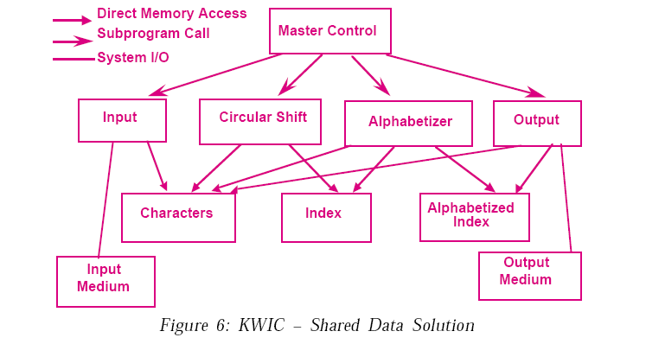
Diagram from Shaw & Garlan: Introduction to Software Architecture (1994)
Notes:
Solution 1: Main Program/Subroutine with Shared Data
The first solution decomposes the problem according to the four basic
functions performed: input, shift, alphabetize, and output. These
computational components are coordinated as subroutines by a main program
that sequences through them in turn. Data is communicated between the
components through shared storage (“core storage”). Communication between
the computational components and the shared data is an unconstrained read
write protocol. This is made possible by the fact that the coordinating program
guarantees sequential access to the data. (See Figure 6.)
Using this solution data can be represented efficiently, since computations
can share the same storage. The solution also has a certain intuitive appeal,
since distinct computational aspects are isolated in different modules.
However, as Parnas argues, it has a number of serious drawbacks in terms
of its ability to handle changes. In particular, a change in data storage format
will affect almost all of the modules. Similarly changes in the overall
processing algorithm and enhancements to system function are not easily
accommodated. Finally, this decomposition is not particularly supportive of
reuse.
Garlan & Shaw: An Introduction to Software Architecture 18

Slide 92
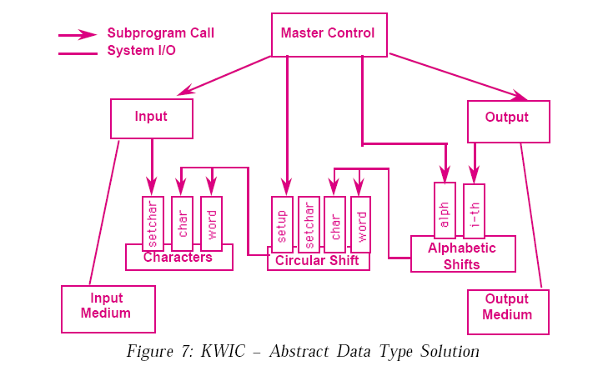
Diagram from Shaw & Garlan: Introduction to Software Architecture (1994)
Notes:
Solution 2: Abstract Data Types
The second solution decomposes the system into a similar set of five modules.
However, in this case data is no longer directly shared by the computational
components. Instead, each module provides an interface that permits other
components to access data only by invoking procedures in that interface.
(See Figure 7, which illustrates how each of the components now has a set of
procedures that determine the form of access by other components in the system.)
This solution provides the same logical decomposition into processing
modules as the first. However, it has a number of advantages over the first
solution when design changes are considered. In particular, both algorithms
and data representations can be changed in individual modules without
affecting others. Moreover, reuse is better supported than in the first solution
because modules make fewer assumptions about the others with which they
interact.
On the other hand, as discussed by Garlan, Kaiser, and Notkin, the solution
is not particularly well-suited to enhancements. The main problem is that to
add new functions to the system, the implementor must either modify the
existing modules—compromising their simplicity and integrity—or add new
modules that lead to performance penalties. (See [7] for a detailed discussion.)
D. Garlan, G. E. Kaiser, and D. Notkin, “Using tool abstraction to compose systems,” IEEE
Computer, vol. 25, June 1992.

Slide 93
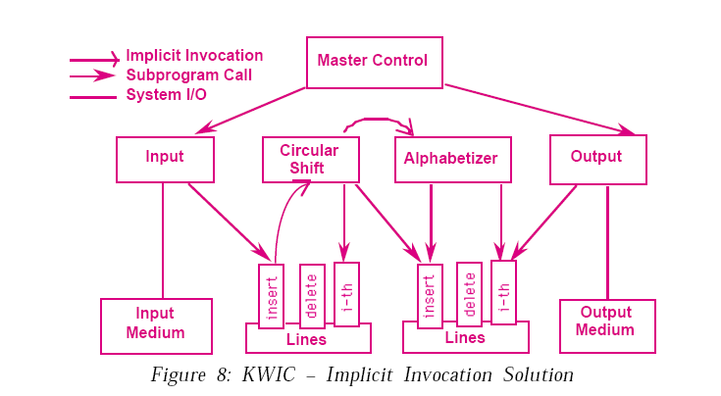
Diagram from Shaw & Garlan: Introduction to Software Architecture (1994)
Notes:
Solution 3: Implicit Invocation
The third solution uses a form of component integration based on shared data
similar to the first solution. However, there are two important differences.
First, the interface to the data is more abstract. Rather than exposing the
storage formats to the computing modules, data is accessed abstractly (for
example, as a list or a set). Second, computations are invoked implicitly as data
is modified. Thus interaction is based on an active data model. For example,
the act of adding a new line to the line storage causes an event to be sent to the
shift module. This allows it to produce circular shifts (in a separate abstract
shared data store). This in turn causes the alphabetizer to be implicitly
invoked so that it can alphabetize the lines.
This solution easily supports functional enhancements to the system:
additional modules can be attached to the system by registering them to be
invoked on data-changing events. Because data is accessed abstractly, it also
insulates computations from changes in data representation. Reuse is also
supported, since the implicitly invoked modules only rely on the existence of
certain externally triggered events.
However, the solution suffers from the fact that it can be difficult to control
the order of processing of the implicitly invoked modules. Further, because
invocations are data driven, the most natural implementations of this kind of
decomposition tend to use more space than the previously considered
decompositions.

Slide 94
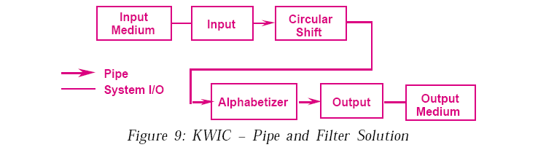
Diagram from Shaw & Garlan: Introduction to Software Architecture (1994)
Notes:
Solution 4: Pipes and Filters
The fourth solution uses a pipeline solution. In this case there are four filters:
input, shift, alphabetize, and output. Each filter processes the data and sends it
to the next filter. Control is distributed: each filter can run whenever it has
data on which to compute. Data sharing between filters is strictly limited to
that transmitted on pipes. (See Figure 9.)
This solution has several nice properties. First, it maintains the intuitive
flow of processing. Second, it supports reuse, since each filter can function in
isolation (provided upstream filters produce data in the form it expects). New
functions are easily added to the system by inserting filters at the appropriate
point in the processing sequence. Third, it supports ease of modification, since
filters are logically independent of other filters.
On the other hand it has a number of drawbacks. First, it is virtually
impossible to modify the design to support an interactive system. For example,
in order to delete a line, there would have to be some persistent shared storage,
violating a basic tenet of this approach. Second, the solution is inefficient in
terms of its use of space, since each filter must copy all of the data to its output ports.

Slide 95
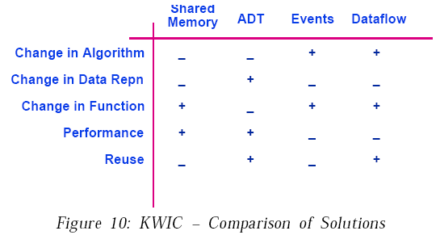
Comparisons
The solutions can be compared by tabulating their ability to address the design considerations itemized earlier. A detailed comparison would have to involve consideration of a number of factors concerning the intended use of the system: for example, is it batch or interactive, update-intensive or query intensive, etc.
Figure 10 provides an approximation to such an analysis, based on the discussion of architectural styles introduced earlier. As Parnas pointed out, the shared data solution is particularly weak in its support for changes in the overall processing algorithm, data representations, and reuse. On the other hand it can achieve relatively good performance, by virtue of direct sharing of data. Further, it is relatively easy to add a new processing component (also accessing the shared data). The abstract data type solution allows changes to data representation and supports reuse, without necessarily compromising performance. However, the interactions between components in that solution are wired into the modules themselves, so changing the overall processing algorithm or adding new functions may involve a large number of changes to the existing system.
The implicit invocation solution is particularly good for adding new functionality. However, it suffers from some of the problems of the shared data approach: poor support for change in data representation and reuse.
Moreover, it may introduce extra execution overhead. The pipe and filter solution allows new filters to be placed in the stream of text processing. Therefore it supports changes in processing algorithm, changes in function, and reuse. On the other hand, decisions about data representation will be wired into the assumptions about the kind of data that is transmitted along the pipes. Further, depending on the exchange format, there may be additional overhead involved in parsing and unparsing the data onto pipes.
Notes:
From Garlan & Shaw: An Introduction to Software Architecture (Tech. Rep) p.22

Slide 96
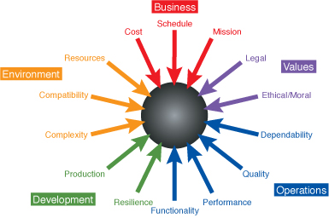
Forces In Software Design
http://www.booch.com/architecture/architecture.jsp?part=Limits-Forces

Slide 97
Making design decisions
To make each design decision, the software engineer uses knowledge of:
the application domain
the requirements
the design as created so far
the technology available
software design principles and ‘best practices’
what has worked well in the past
Combination of
top-down and bottom-up
Slide by Lethbridge and Laganiere

Slide 98
Dijkstra on Artificial Intelligence
The question of whether Machines Can Think... is about as relevant as the question of whether Submarines Can Swim.

Slide 99
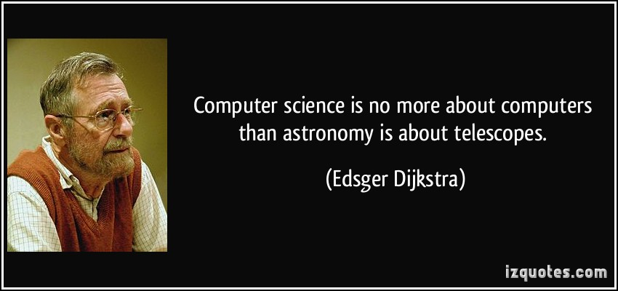

Slide 100
( Forall i : 0<i<=N :
( For all j: 0<j<=N: i<j => A[ i ]<=A[ j ] ) )
…… program derivation ….
program that does SSSS

Slide 101
Starting with a post-assertion, what is the weakest pre-condition that makes the assertion true?
In other words, what must be true before to make the assertion true after?
[WP ^ [ action ] ] ==> Assertion

Slide 102
Deployment Example
UI
UI
UI
UI
Student
Reg.Off.
Internet
Client
Library
Dorm
Internet
Local Area Network
Registration
Firewall
Database
Server
Gateway

Slide 103
Summary of key architecting practices
Understand the drivers for the project (business, politics)
Get stakeholder involvement early and often
Understand the requirements incl. quality properties
SMART & prioritized
Develop iteratively and incrementally
Describe architecture using multiple views
abstract, but precise, design decisions & rationale
Design for change (modularity, low coupling, inform. hiding)
Analyze in an early stage (use maths! and scenarios)
Simplify, simplify, simplify
Regularly update planning and risk analysis
Monitor that architecture is implemented
Get good people, make them happy set them loose

